Slide 1

LU2: Strategic Frameworks for the Digital Age
Mastering modern analytical tools, platform dynamics, digital value chains, and transformation maturity roadmaps.
DELIVERY DURATION
SCHEDULED BREAK
STRUCTURE
3 Hours (180 Mins)
15 Minutes
4 Learning Outcomes + 4 Activities

Slide 2









Overall Unit Learning Outcomes
Adapt Strategic Tools
Digital Value Chains & BMC
Adapt classic tools (SWOT, PESTLE, Porter's 5 Forces) to evaluate digital industry dynamics and platform economies.
Design and reconfigure digital value chains and Business Model Canvases (BMC) for tech-driven ventures.
Blue Ocean & Innovation
Digital Maturity & Roadmap
Apply Blue Ocean Strategy and disruptive innovation principles to unlock uncontested market space in digital sectors.
Utilize digital maturity models and diagnostic tools to benchmark readiness and guide transformation roadmaps.

Slide 3
LO1: Adapting Strategic Analytical Tools
Evaluating Platform Economies & Digital Industry Dynamics through Modernized Strategic Frameworks

Slide 4



LO1: Modernizing Classic Strategic Analytical Tools
Shift to Digital Frameworks
Traditional frameworks were built for linear pipeline businesses. In digital ecosystems, parameters change rapidly:
Digital SWOT: Focuses on data assets, API ecosystems, and rapid technological obsolescence over traditional physical assets.
Digital PESTLE: Emphasizes algorithmic regulation, cybersecurity mandates, cloud adoption, and ESG tech compliance.
Digital Porter's 5 Forces: Incorporates multi-sided market effects, zero-marginal cost threats, and user lock-in through platform network loops.

Slide 5




LO1 Activity: Platform Economy Matrix Workshop
Evaluating Platform Network Effects with Digital Porter's 5 Forces
Task Instructions
Deliverable & Output
Select a major platform venture (e.g., Ride-sharing, Cloud Marketplace, or FinTech App).
Produce a 1-page Digital Porter’s Matrix identifying the single greatest structural vulnerability of your assigned platform enterprise.
Map out the Direct & Indirect Network Effects strengthening platform retention.
Re-evaluate Porter's 5 Forces: Analyze threat of substitutes in a low-friction API environment.

Slide 6
LO2: Digital Value Chains & Business Model Canvas
Reconfiguring Tech-Driven Value Architecture and Scalable Monetization Canvases

Slide 7


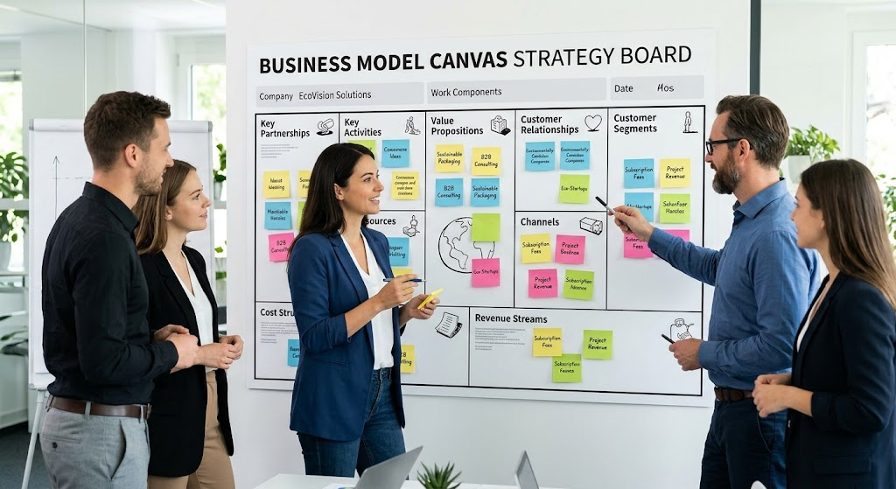
LO2: Reconfiguring Digital Value Chains & BMC
Key Value Architecture Shifts
Linear to Ecosystem Value Chains: Shifting from supplier-to-customer pipes to automated ecosystem loops with third-party integrators.
Key Resources: Data assets, machine learning models, cloud infrastructure, and proprietary algorithms replace physical hardware.
Cost Structure Optimization: Shifting high CapEx to operational cloud OpEx with near-zero marginal cost of scaling.
Revenue Streams: Subscription (SaaS), freemium usage, marketplace transaction take-rates, and data monetization.

Slide 8




LO2 Activity: Reengineering Tech Business Model Canvas
Transforming a Legacy Enterprise into a Tech-Driven BMC
Step 1: Scenario Brief
Step 2: Canvas Re-design
Step 3: Pitch & Defend
Take a traditional brick-and-mortar logistics or retail company struggling with traditional overhead.
Pivot 3 core building blocks: Channel (API/App), Value Proposition (AI personalization), and Revenue (Subscription).
Present your transformed digital value chain to peers, demonstrating lower operational drag.
SCHEDULED REFRESHMENT BREAK
15 Minutes Duration (Following LO2 Completion)

Slide 9
LO3: Blue Ocean Strategy & Innovation
Unlocking Uncontested Market Space in Digital Sectors via Disruptive Innovation

Slide 10


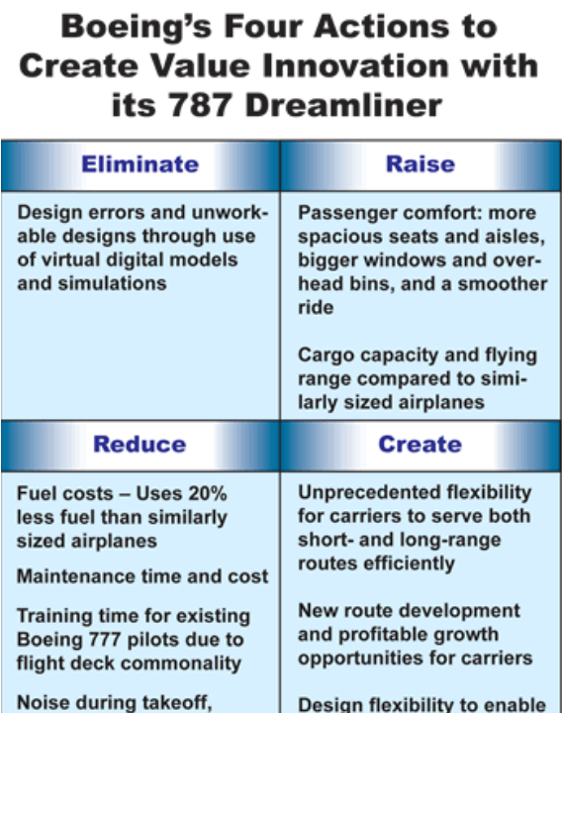
LO3: Creating Uncontested Market Space
Principles of Digital Blue Ocean
Rather than competing in crowded "Red Oceans" of head-to-head pricing, tech ventures leverage four action frameworks:
Eliminate: High sales commissions, physical branches, legacy hardware infrastructure.
Reduce: Customer onboarding friction, manual transaction verification times.
Raise: Algorithmic accuracy, user interface speed, ecosystem interoperability.
Create: Entirely new value curves (e.g., on-demand access, predictive automation).

Slide 11






LO3 Activity: Digital Value Curve Innovation Sprint
Drafting a Disruptive Digital Four Actions Matrix (ERRC)
ELIMINATE
REDUCE
What traditional industry factors should be completely removed?
What factors should be reduced well below industry standards?
RAISE
CREATE
What factors should be raised well above industry standards?
What new value sources should be created that the industry never offered?
Deliverable: Plot your new digital value curve against the dominant incumbent on a visual chart.

Slide 12
LO4: Digital Maturity Models & Transformation
Benchmarking Organizational Readiness & Navigating Transformation Roadmaps

Slide 13


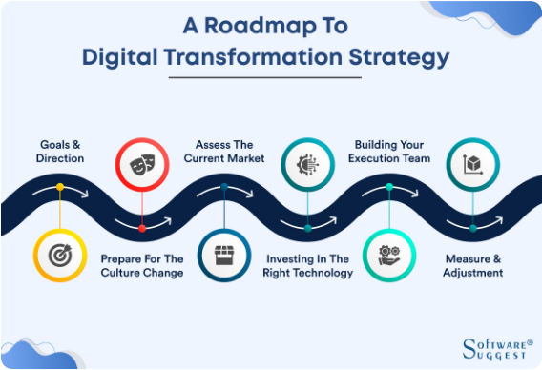
LO4: Digital Maturity Diagnostics & Roadmaps
4 Pillars of Digital Maturity
Digital Culture & Leadership: Agility, innovation tolerance, data-driven decision making.
Technology Stack Architecture: Cloud-native systems, API readiness, security compliance.
Data & Analytics Capabilities: Real-time telemetry, predictive insights, unified data models.
Operations & Process Automation: CI/CD workflows, automated customer touchpoints.

Slide 14




LO4 Activity: Diagnostic Benchmark & Action Roadmap
Assessing Organizational Readiness & Designing Phase 1 Roadmap
Readiness Assessment
90-Day Execution Roadmap
Evaluate a case organization across the 5 Stages of Maturity (Ad-hoc → Emerging → Centered → Scale → Optimized).
Formulate 3 immediate high-impact quick wins for leadership buy-in and digital architecture upgrade.
End of Learning Unit 2: All 4 Learning Outcomes Mastered

Slide 15




Image Sources
https://www.trainingjournal.com/wp-content/uploads/2026/07/using-ai-business-team-discussing-ai-analytics-and-digital-strategy-during-a-corporate-meeting-professional-presentation-with-ai-data-dashboards-charts-and-technology-insights-in-a-modern-office-stockpack-adobe-stock.jpg
Source: www.trainingjournal.com
https://oecd-opsi.org/wp-content/uploads/2019/02/1LBAHaRSx2IajordnTkA_1200px-Business_Model_Canvas.png
Source: oecd-opsi.org
https://www.frontierstrategy.com/0_ERRC_Grid/Boeing_ERRC_Grid.png
Source: www.frontierstrategy.com
https://blogimages.softwaresuggest.com/blog/wp-content/uploads/2022/10/How-to-create-a-digital-transformation-strategy-for-success_middle-images_09.jpg
Source: www.softwaresuggest.com

